Slide 1
CSE 231 Digital Logic Design
Tanzilur Rahman (Tnr)
Assistant Professor
North South University

Slide 2
Information…..
Lecture Room: NAC 922
Lecture Time: ST 09:40 – 11:10 (Section 4)
ST 11:20 – 12:50 (Section 5)
Lab Room: Digital Microprocessor Laboratory, 5th Floor of SAC Building
Office: SAC 1022
Office Hours: 1.00 - 2.15 PM (S,T,M,W)
Email: tanzilur.rahman@northsouth.edu
Phone: 02 55668200 Ext. 6182
Course Web : https://sites.google.com/site/neuro11school/

Slide 3
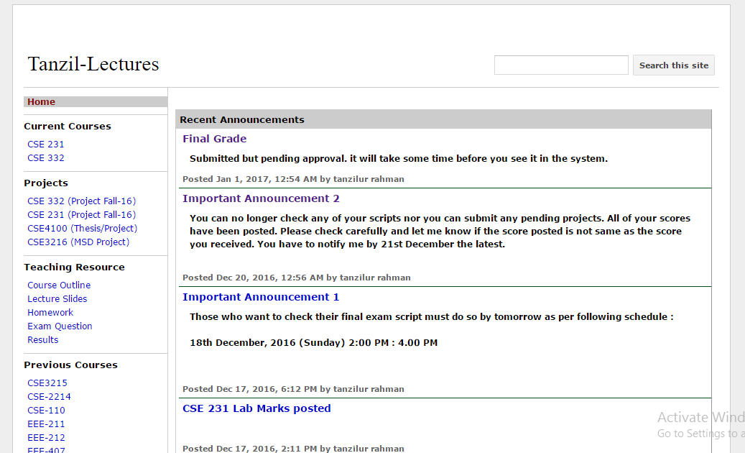
Resource….
Visit https://sites.google.com/site/neuro11school/home

Slide 4
Digital Logic Design _{prerequisite knowledge?}
Let me ask you few questions first…..
Did you take course on electrical circuits ??
Did you take course on electronics (Analog) ??
Do you know about signals (Analog/digital) ??

Slide 5
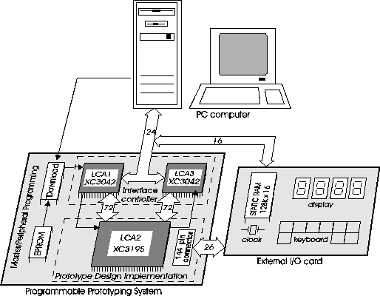
Digital Logic Design _{where do you find it?}
Take the most familiar system example next…..

Slide 6
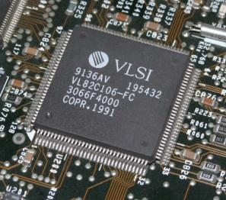
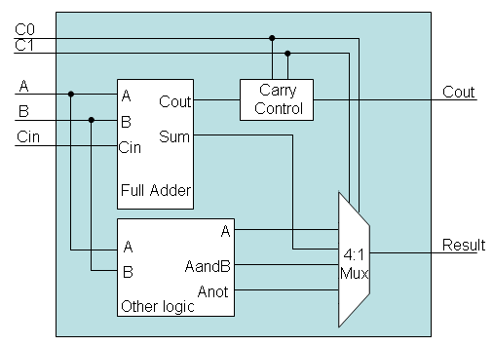
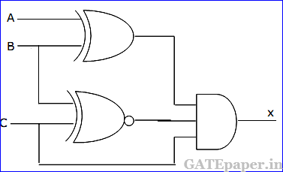
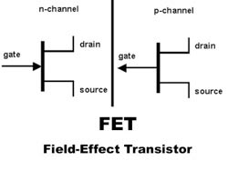
Digital Logic Design _{where does it fit?}
Design to fabrication
EEE 435
Digital Systems Design
(Ex. Computer/Mobile Processor)
CSE 332
Digital Logic Circuits
(ALU, Memory)
CSE 231
Logical components using transistors
EEE111

Slide 7
Course Description:
This course provides an introduction to logic design and basic tools for the design of digital logic systems. A basic idea of number systems will be provided, followed by a discussion on combinational logic: logic gates, Boolean algebra, minimization techniques, arithmetic circuits (adders, subtractors), basic digital …………………………please read more from the outline

Slide 8
Course Objective:
After the completion of the course, the students will be able to:
Apply the principles of Boolean algebra to logic functions.
Use K-maps to realize two-level minimal/optimal combinational circuits
Understand the operation of latches, flip-flops, counters and registers.
Analyze and design sequential circuits built with various flip-flops.
Appreciate the ease and versatility of design using programmable logic.

Slide 9
Textbook:
Digital Design
By Morris Mano and Michae D. Ciletti, 5th Edition
Digital Design: Principles and Practices,
By J F Wakerly, 4thed, Prentice Hall, 2005
Digital Logic Techniques,
By T J Stonham, 3rded, Chapman & Hall, 1996
Or any good textbook on Digital Logic Design
So what do I mean by references ???

Slide 10
Class Structure:
1. Lectures : Attendance and participation of all of them are strongly encouraged.
2. Laboratory : You must pass in your lab to attain a passable grade in theory. 20% marks from your lab will be directly added to your theory
3. Assignments : You will be given some design assignments. You will use pen and papers and tools to solve those problems.
4. Projects : You will have to submit a hardware design project at the end of the semester. You will work on the project as a group.
5. Exams: There will be one midterm, one final exam and zero make-ups .

Slide 11
Distribution of Points:
*Digital Laboratory ----------------------------------------- 20 %
Attendance ---------------------------------------- 5 %
Project/Assignment ---------------------------------------- 15 %
Quizzes -------------------------------------------------- 10 %
Term Examination ----------------------------------------- 25%
Final Examination (comprehensive) ------------------------- 25%
*Must obtain 60% marks in CSE231L

Slide 12
Lecture Topics:
Topics Effort in (Min.)Hr
Numerical representation of numbers 2 hours/wk
Boolean algebra 2.5 hours/wk
Combinational logic design 3.5 hours/wk
Combinational circuits 4 hours/wk
Synchronous sequential logic 6 hours/wk
Sequential circuits: Registers
and counters 4 hours/wk
Memory design (RAM, ROM) &
Programmable logic: 3.5 hours/wk

Slide 13
Digital Laboratory
Will be conducted by the Lab Instructor (TBA)
Lists of experiments and outline will be provided in the first lab.
Will be graded separately

Slide 14
Projects:
Software Laboratory :
Apart from Digital Laboratory, I will conduct few lectures in computer
labs. This will help you to do your own projects rather than copying others.
Tentative Lectures:
Lab 1 : Logisim Introduction
Lab 2 : Combinational system design
Lab 3 : Sequential System Design
Lab 4 : Combining a system (Combinational & Sequential )
Lab 5 : Introduction to HDL
Will discuss more on projects as the semester progress….

Slide 15
Important Dates:
Quizzes After completion of every topic
Term Examination March 1st wk~ 2nd wk
Final Examination During final exam wk

Slide 16
Very important question….
Am I strict to the grading policy ?
No. It is decided at the end of the sem. Last sem. grading range was
Percent Grade
90% A
87% A-
82% B+
79% B
74% B-
71% C+
67% C
64% C-
61% D+
53% D
below 53% F

